Slide 1
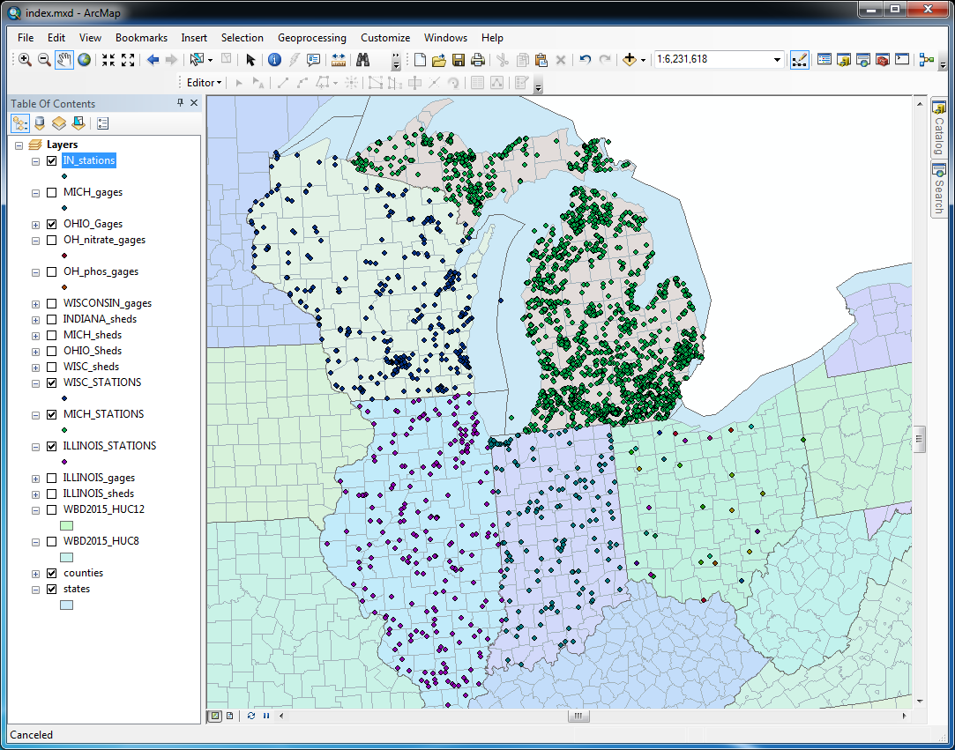
How did I get this data
Larry Theller
Sept 2016

Slide 2
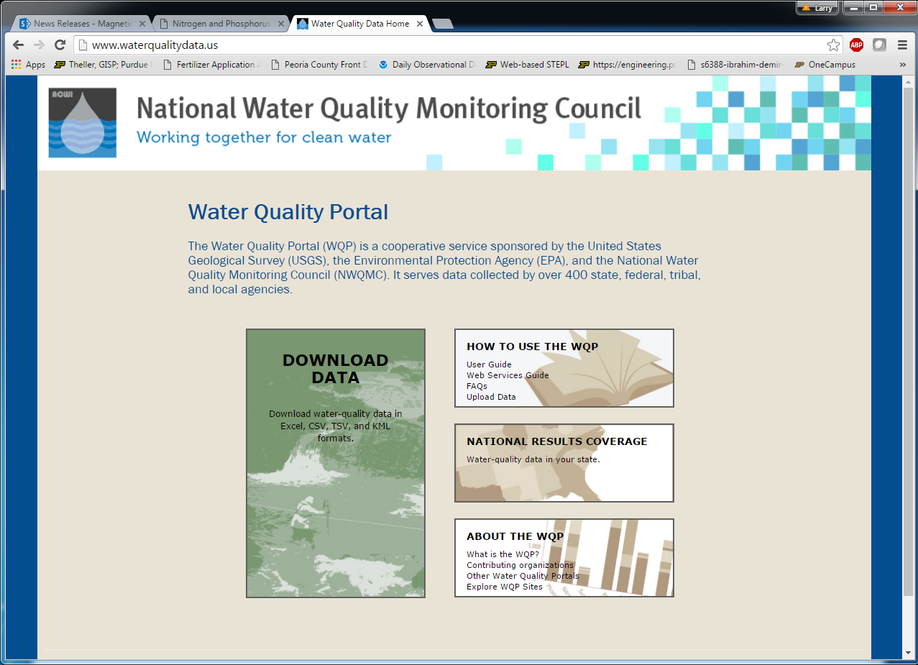
http://www.waterqualitydata.us/

Slide 3
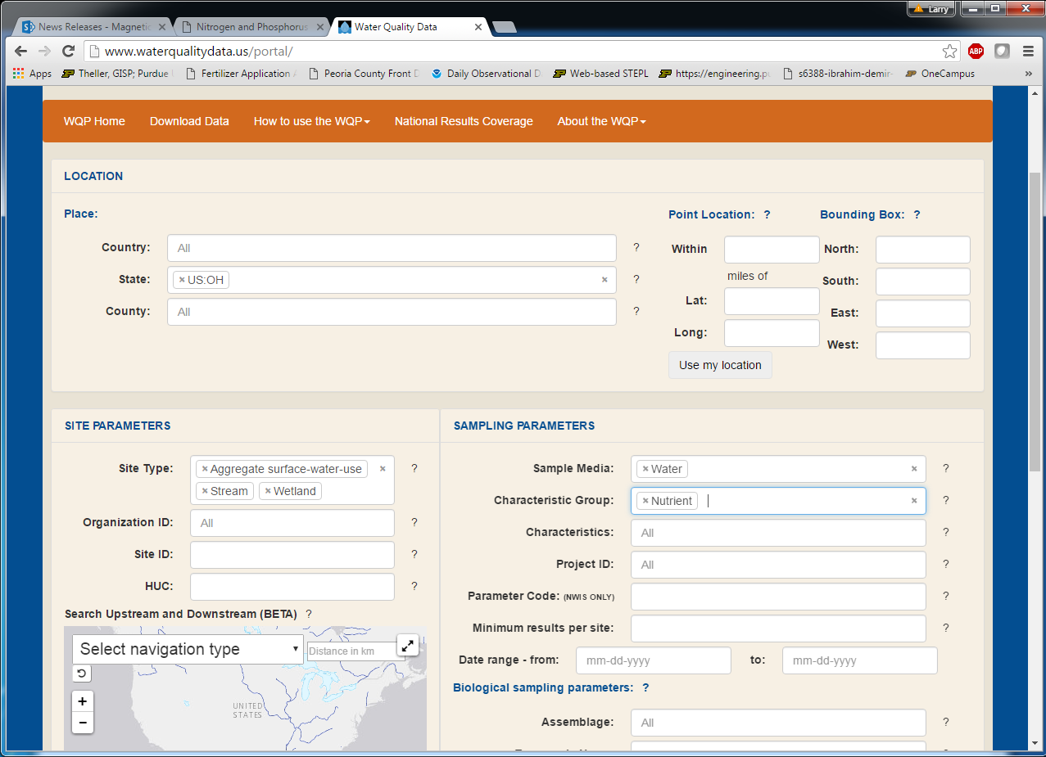
Depending upon how state listed these in database, select multiple site types ( e.g. both ”streams” and “surface water”. May need to iterate on this.

Slide 4
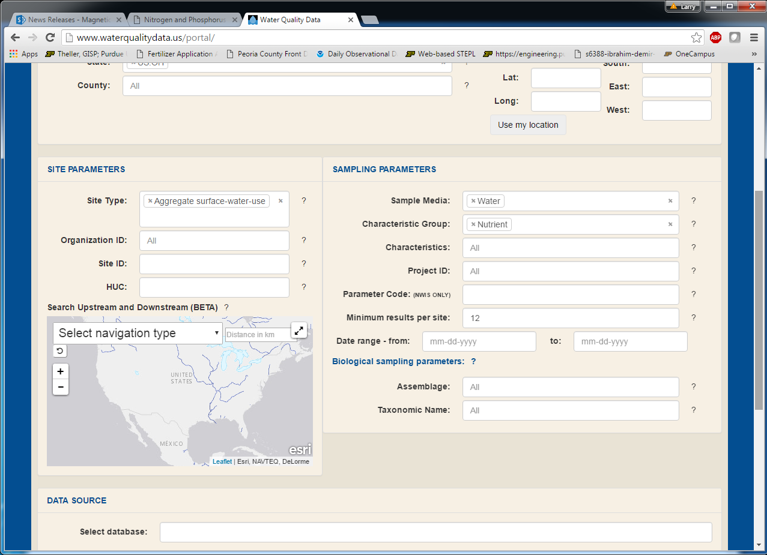
For calibration studies I might request only sites with >12 results, etc.

Slide 5
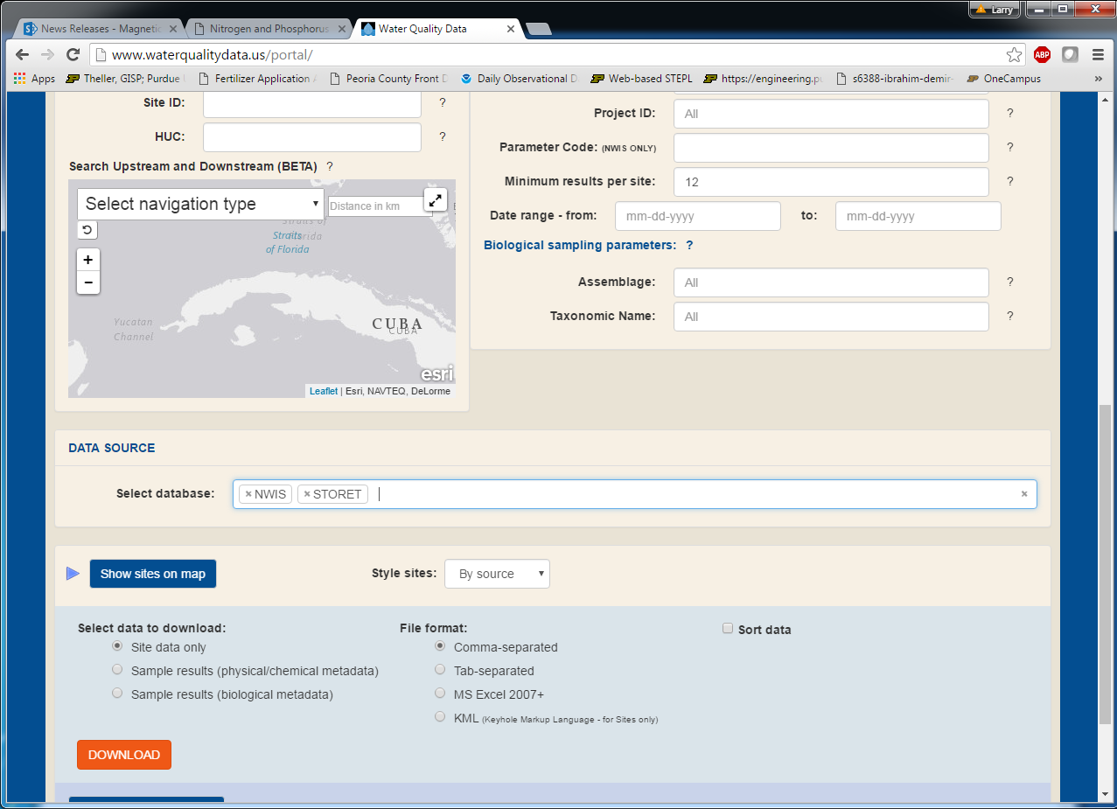
Select both NWIS and STORET databases

Slide 6
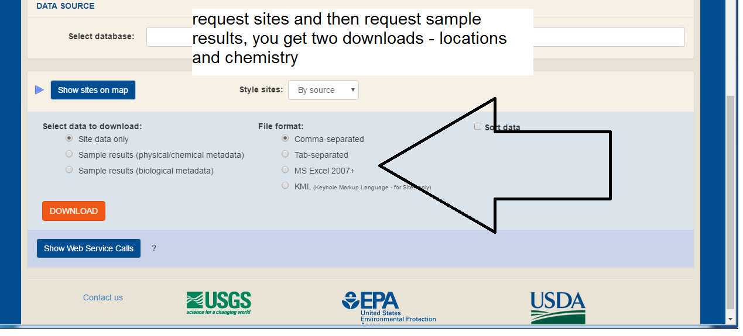

Slide 7
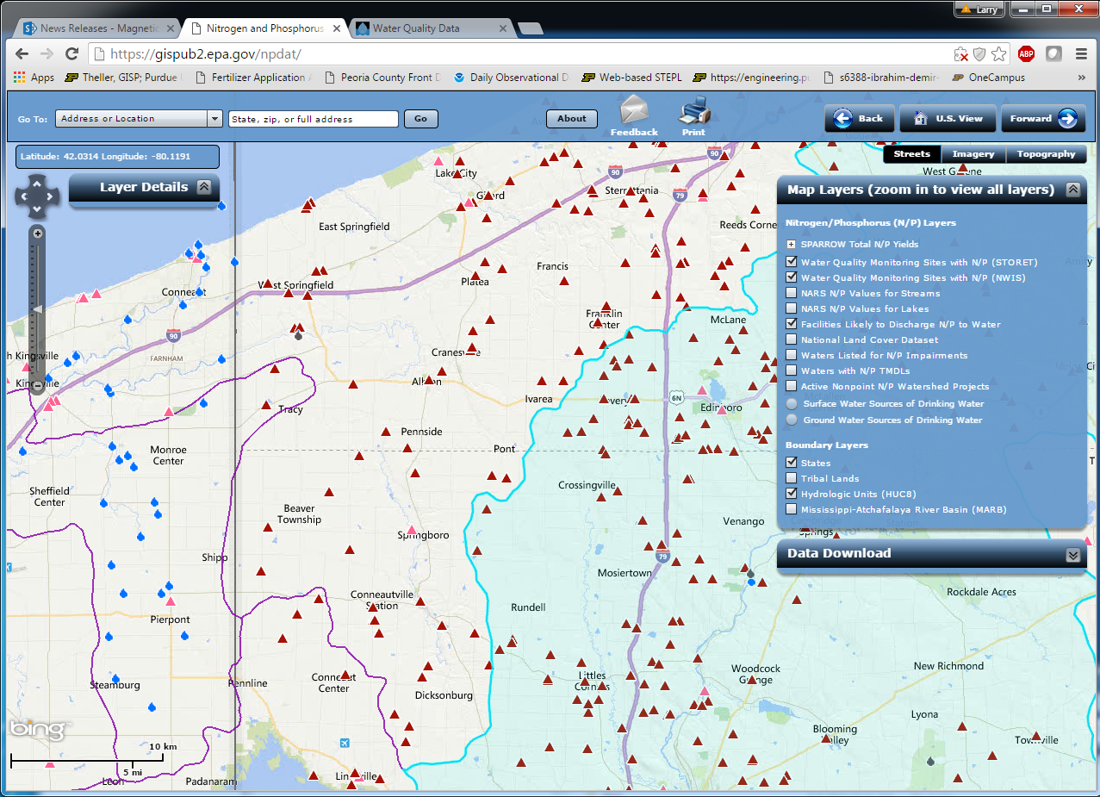
Also of interest – Nitrogen/Phosphorous emitting facilities https://gispub2.epa.gov/npdat/

